Slide 1
xPlorer Plugin Demo
Author: John Kang
Notes:
Todo List:
Look at performance run of set events

Slide 2
Purpose
“Explorer filter on steroids” – Matt
To analysis performance of the drive
Give QOS by measuring the time each command takes.
To link events to allow for more efficient debugging
Grouping SET events and outputting to a CSV file
Counting number of SET events
Sequential SET events (events that don’t have matching parameters)

Slide 3
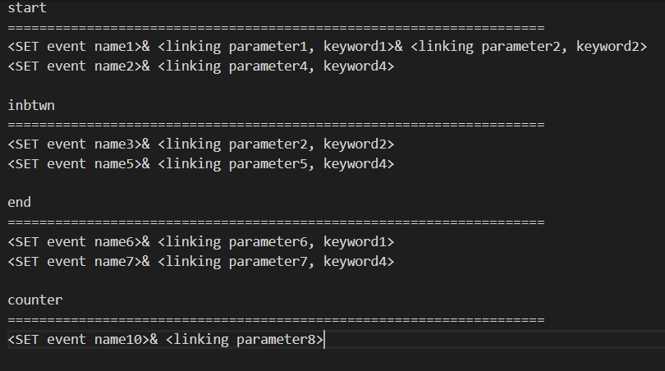
Configuration file tutorial
First part of each line is the EXACT SET event name
Delimited by “&” because none of the SET events and parameters use “&”
Divided into sections to indicate to the program that there is specific logic that needs to be performed on each section
Can be expanded through the Java file

Slide 4
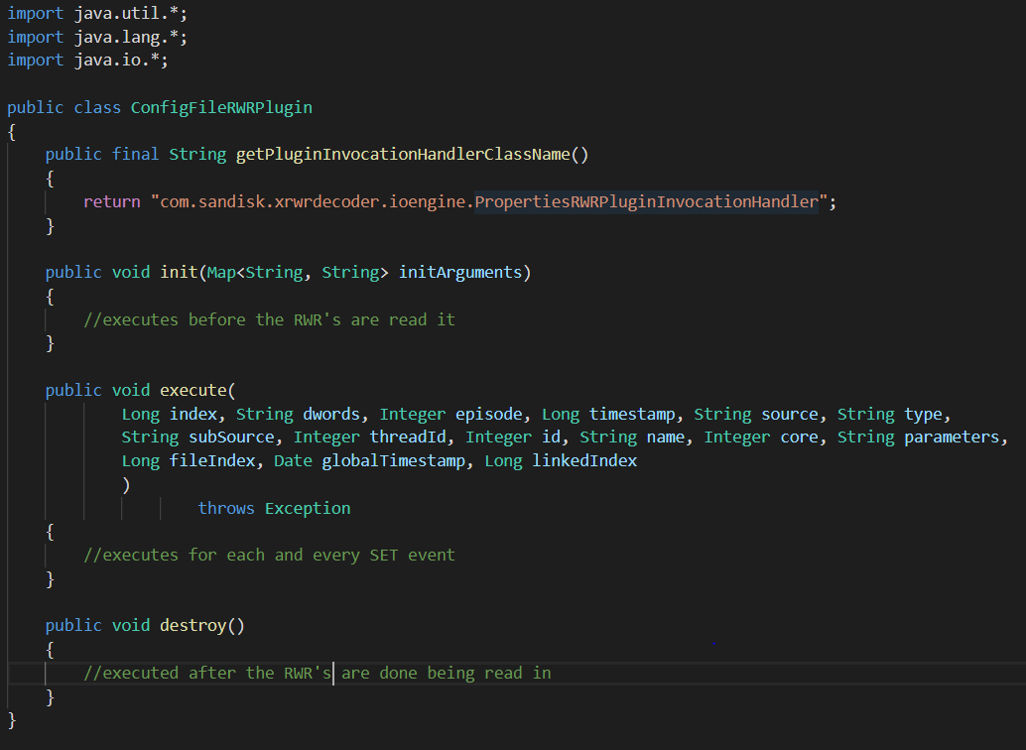
Java Plugin Code Tutorial
Init
Logic performed before the RWR files are read
Execute
The logic here will execute on every SET event read in
Destroy
Logic here will execute after all the RWR files are read
Like any Java Class, helper functions and methods can be added to help with logic

Slide 5
xPlorer CLI tutorial
Running Session Live
File Path to CMD: C:\xTools\app\xplorer\
START: xplorer-cli.bat session create --session-configuration-file=<path to json configuration file> --start=true (*need JSON configuration file)
STOP: xplorer-cli.bat session stop --session-id=<session-id>
Already have RWR files from GUI
File Path to CMD: C:\xTools\app\xrwrdecoder\
START: xrwrdecoder-cli.bat process decode
--product=<product name> --run-mode=READ
--rwr-path<path where RWR files are> --dco-path=C:\RWR\SetDictionary.dco
--output-type=NONE
--plugin-classes=<name of plugin class> --plugin-source-directory=<folder of plugin>

Slide 6
Small live run during the presentation
Only using One 100Mb RWR file
Running event counter and time delta of command
Showing how to use plugin on previous RWR files
Could do a 60 second test live test too?
diskspd64.exe -w0 -b128K -o32 -t1 -S -L -W5 -d60 S:\SLC.bin 1>C:\Diskspd_Log\SLC_128KiB_SeqRead_QD32.log
xplorer-cli.bat session create --session-configuration-file=C:\xTools\informer_json_2.9.5.json --start=true
xplorer-cli.bat session stop --session-id=<session-id>
- Session id can be found in the value section when the session gets created (displayed in the console window)

Slide 7
Recommendation from Israel
Make sure your plugin output is written to a file and not to the console. (in the destroy method)
It is recommended to use "policy": "ON_STOP" in execute command in order to avoid collision of data.
In the JSON file

Slide 8
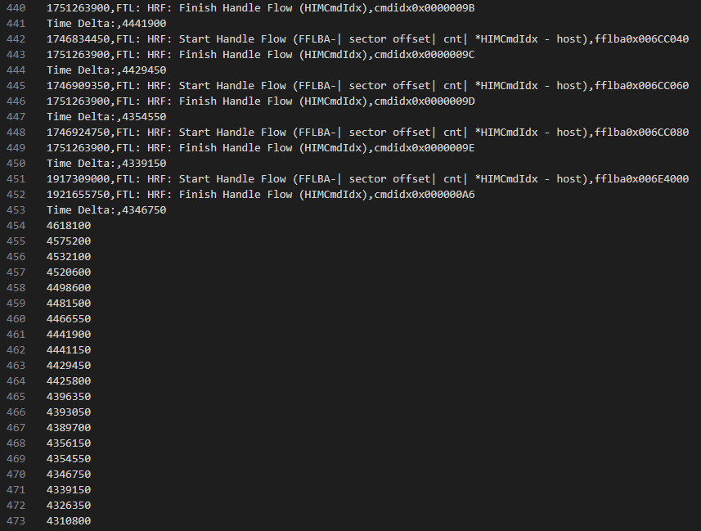
Output

Slide 9
Q & A

Slide 10
References
Plugin User Manual
https://confluence.wdc.com/display/SWT/Plugin+User+Manual
Recording with Plugin using CLI
https://confluence.wdc.com/pages/viewpage.action?spaceKey=SWT&title=Recording+with+plugin
RWR Plugin Examples
https://confluence.wdc.com/display/SWT/RWR+Plugin+Examples

